Slide 1
Post Weaning Diarrhea

Slide 2
Team Members
Sarah Mahmoud(Graphics outliers-hypothesis testing)
202000408
Youmna Tarek(Data Reading-Descripting Statistics-
hypothesis testing)
202001016
Under the supervision of
Dr/ Mohamed Maysara
Merna Salem
202000948
202001764
Mohamed Elteweay
Saturn is a gas giant and has several rings
Venus has a really beautiful name

Slide 3
Hypothesis Testing
1
4
Data Reading
7
Outliers Detection
Table
of
content
Descriptive Statistics
2
5
Normality,
Homoscedasticity
check
3
8
6
Statistical Inference
Graphics
Linear Model

Slide 4
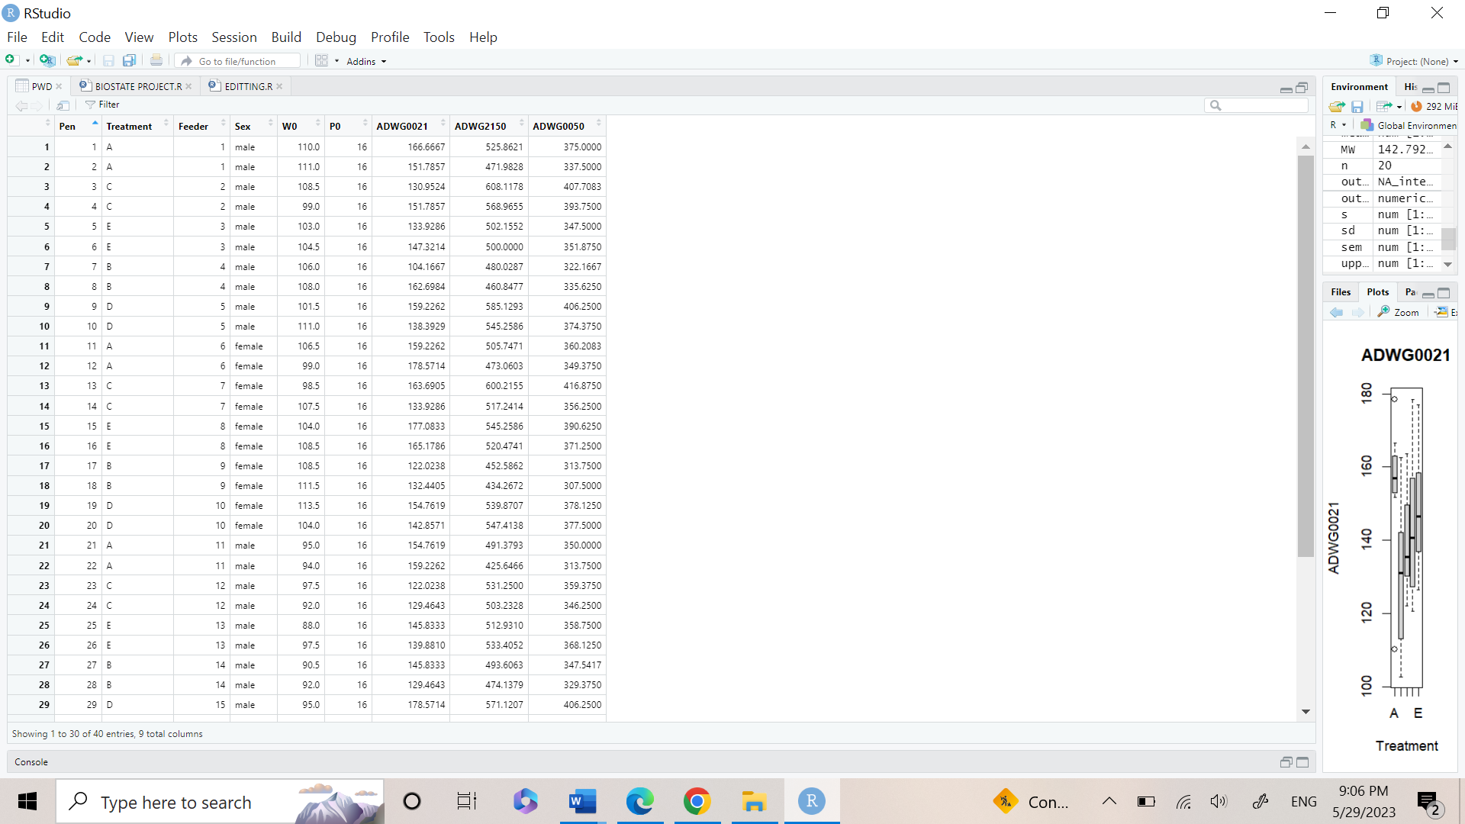
0.Data Reading
After reading the data by loading it in R we analyze it and found that the data contains nine columns which are:
Pen-treatment-feeder-sex-W0-P0
ADWG0021
ADWG2150
ADWG0050.
ADWG0021, ADWG2150, ADWG0050: average daily weight gain (g/day) in the period between 0- and 21-days post-weaning, between day 21 and day 50 post-weaning and in the period between 0- and 50-days post-weaning, respectively.
Our Dataset

Slide 5
1.Decriptive statistics
1
3
2
Data Summary
Frequency table
Calculating
Correlation

Slide 6
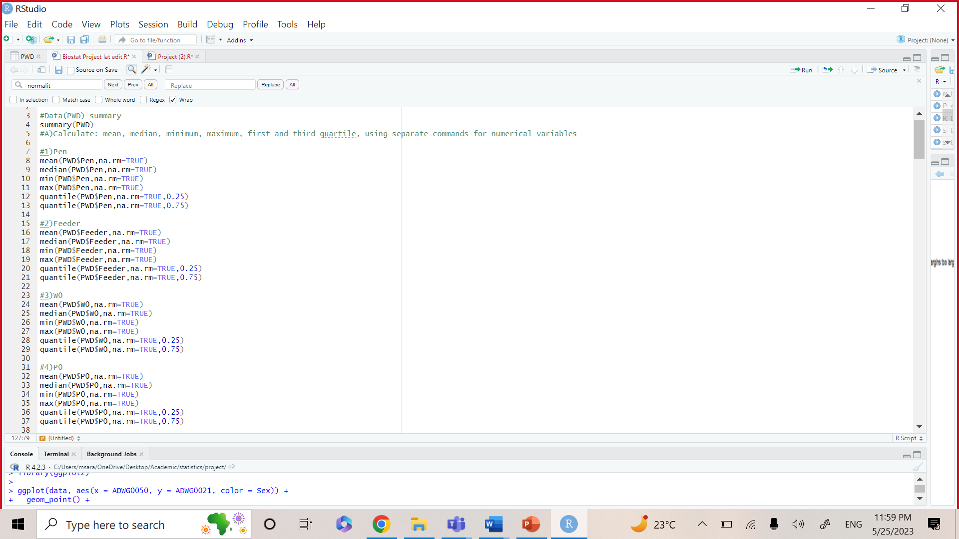
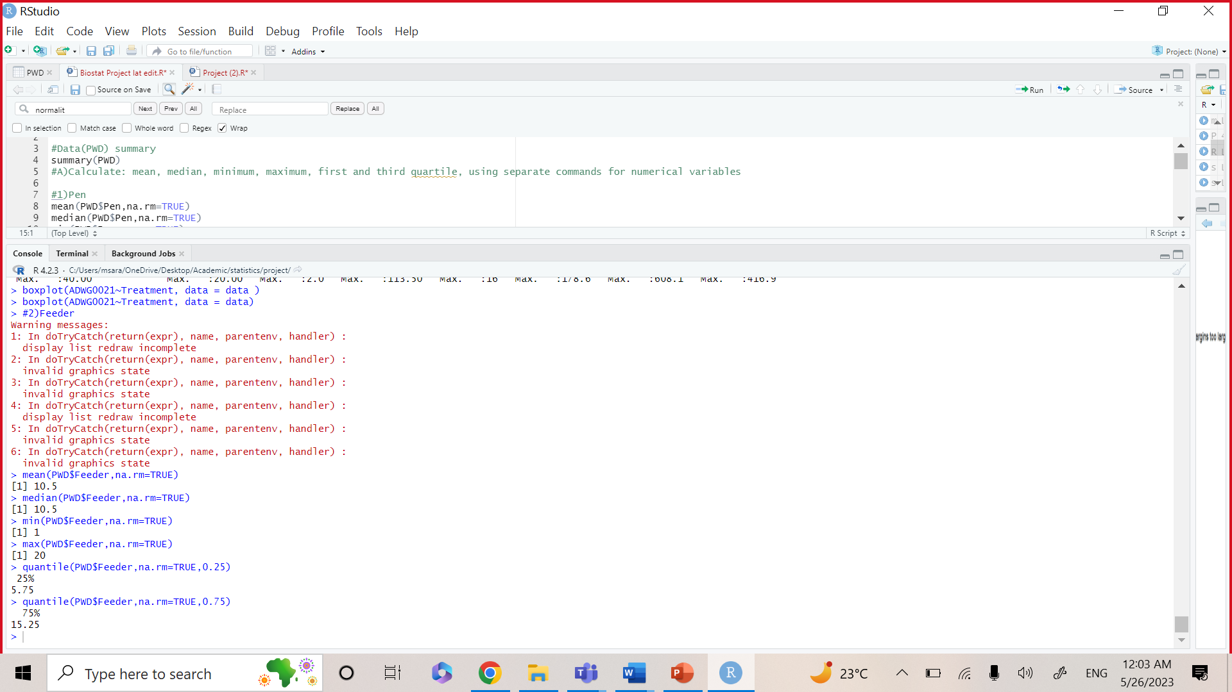
1.Decriptive statistics
A)Data Summary, and calculating mean , median , minimum, maximum, first and third quartile for each variable of our data(PWD)
Sample output

Slide 7
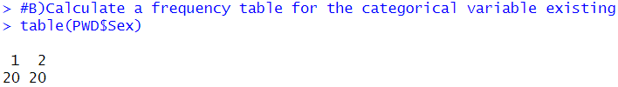
1.Decriptive statistics
B) For the categorical variable existing, calculate a frequency table :
The table for categorical variables existing shows up that our data contains two dependent variables 20 males and 20 females.
Sample Output

Slide 8
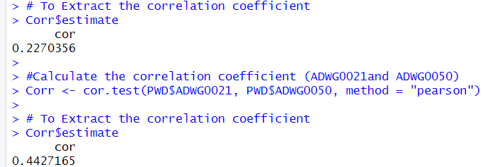
1.Decriptive statistics
Calculating the correlation coefficient (ADWG0021 and ADWG2150)
Based on output: Correlation coefficient =0.227035 > 0 . ADWG0021 and ADWG2150 have (weak) positive correlation
Calculating the correlation coefficient (ADWG0021and ADWG0050)
Based on output: Correlation coefficient =0.4427165 > 0 . ADWG0021 and ADWG0050 have (weak) positive correlation

Slide 9
2.Graphics
Bar Chart
Distribution of numerical variable against categorical variable.
Histogram
Displays the frequency of each value or range of values in the dataset
Scatter plot
Display of two numerical variables in which each observation is described as point in the graph
Box plot
Useful for detecing outliers and checking variance.

Slide 10
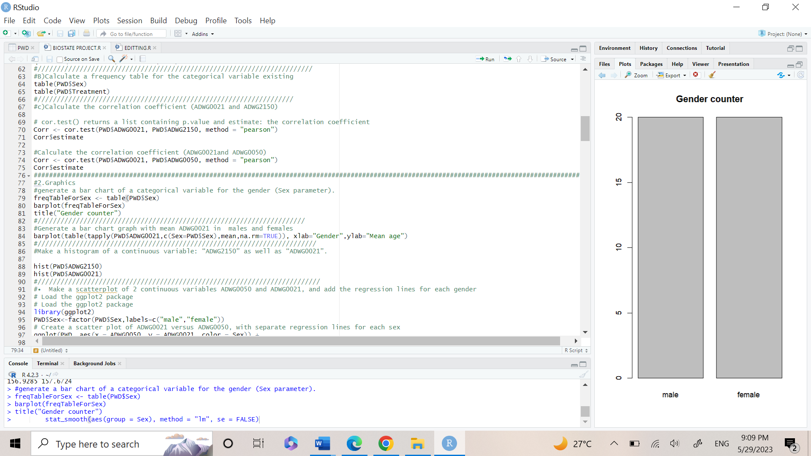
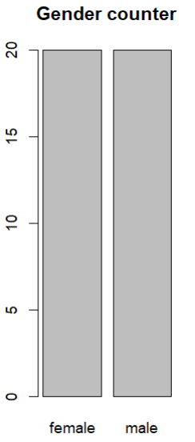
2.Graphics
3.1)Frequency table for males and females.
The code
Bar charts and frequency tables are often used together to explore and visualize categorical data.
The frequency table provides a summary of the data, while the bar chart provides a visual representation of this summary
Male | Female
20 | 20

Slide 11
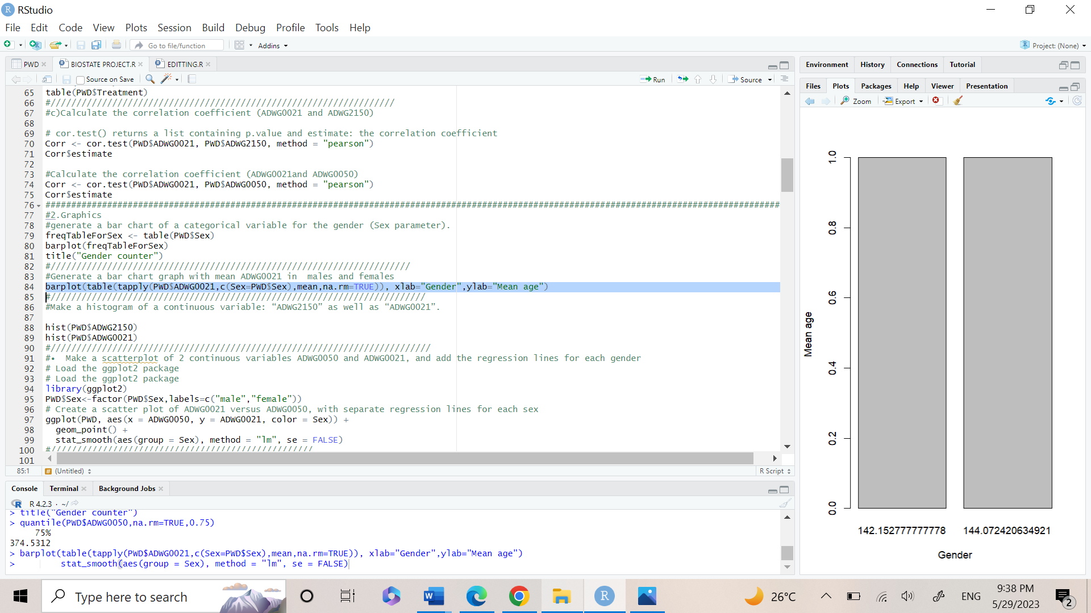
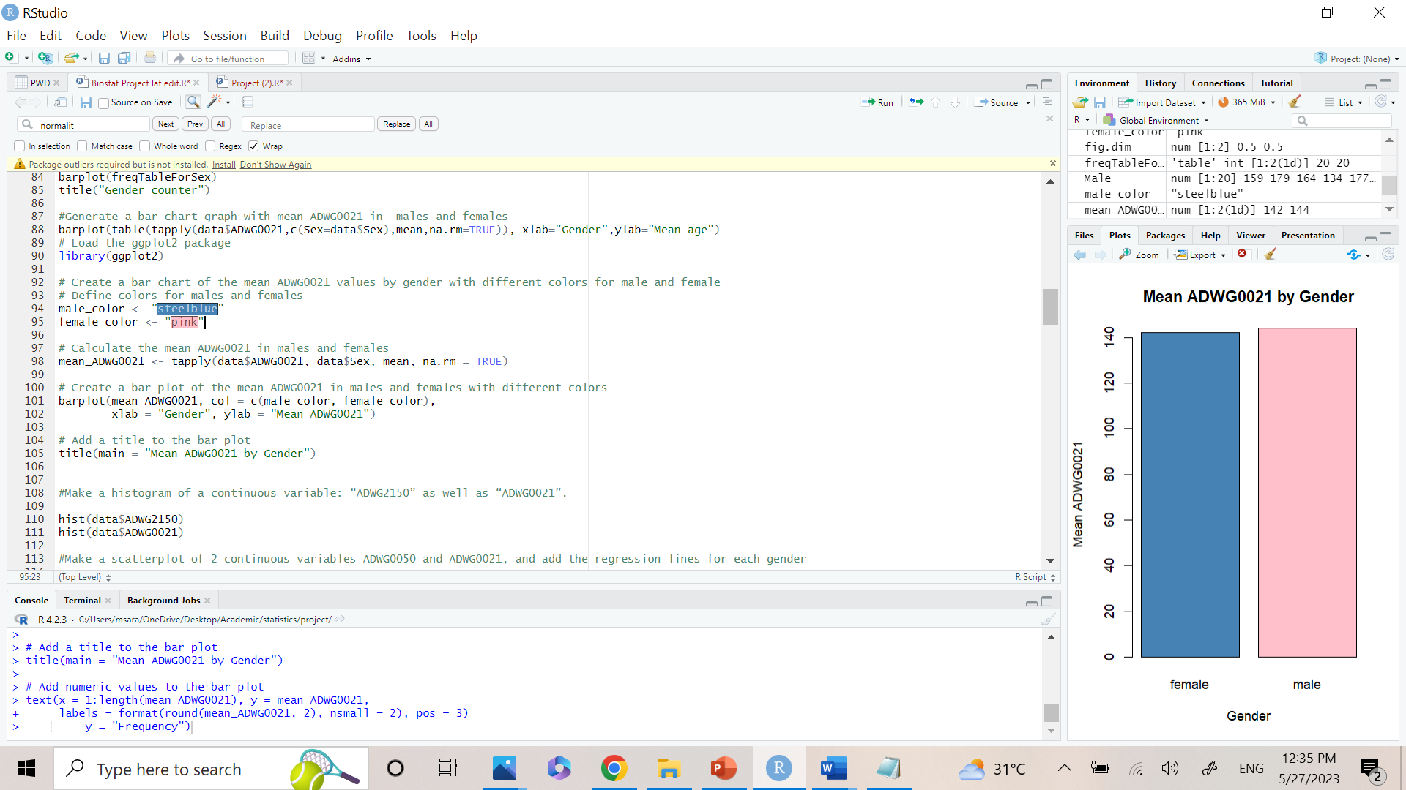
2.Graphics
3.2)Bar chart with mean ADWG0021 in males and females
The code
The result shows the mean value of ADWG0021 in males and females.
The mean of males is slightly greater than females.
Male | Female
144 | 142.15

Slide 12
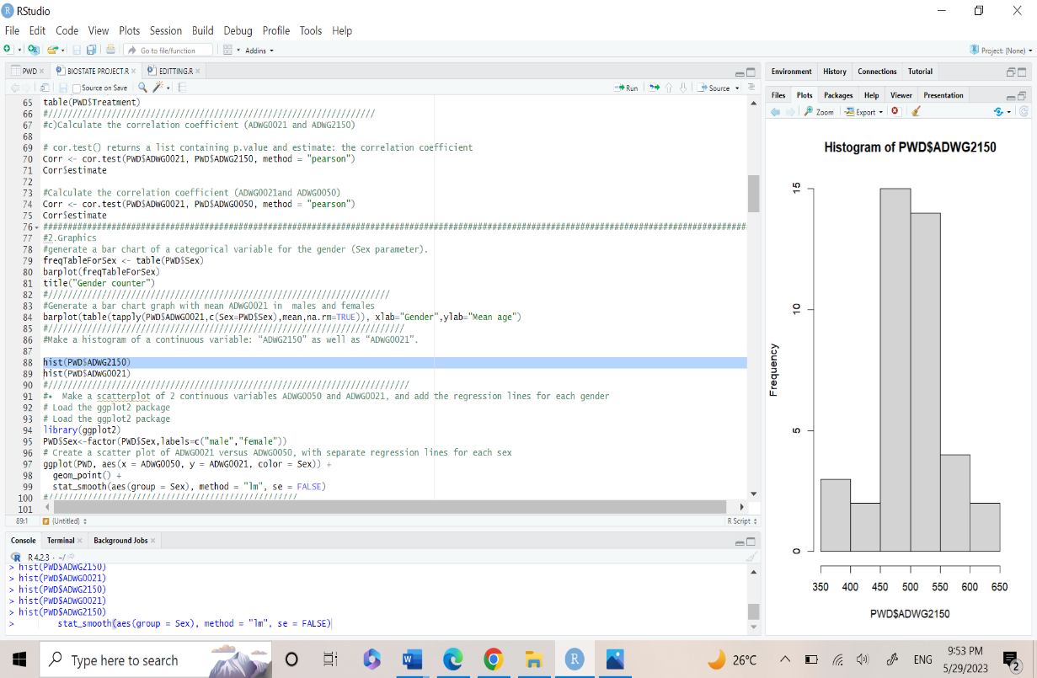
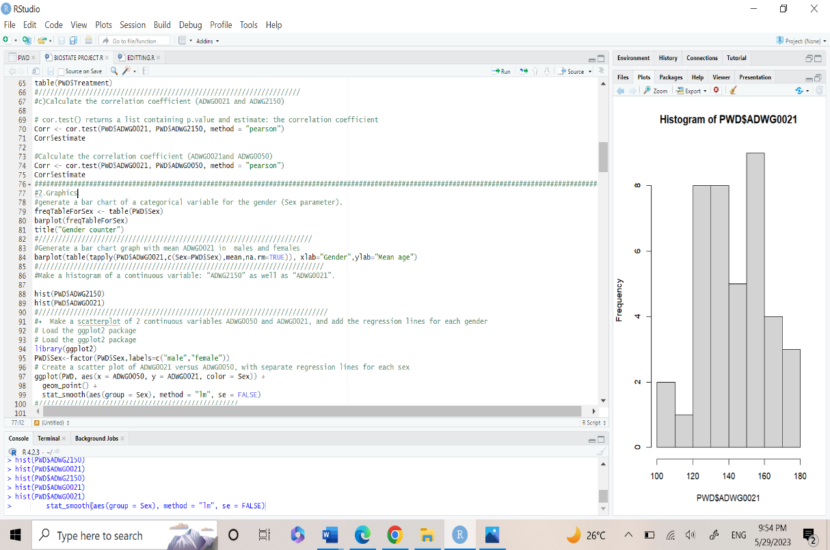
2.Graphics
3.3) Histogram of a continuous variable: “ADWG2150” and “ADWG0021”.
The code
Histograms are useful for visualizing the shape of the distribution of a continuous variable, and its center, spread, and skewness.
It can be used to check normality
Both histograms reflect normality.

Slide 13
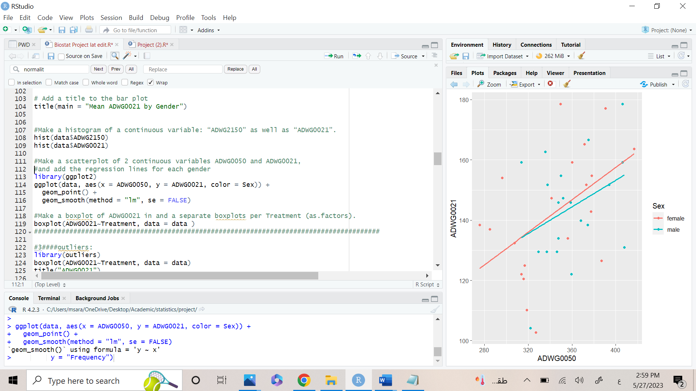
2.Graphics
3.4)Scatterplot of 2 continuous variables ADWG0050 and ADWG0021 for each gender.
The code
Scatter plot is used to describe relation between two numerical variables.
It is used to describe correlation between two variables
If data is following a linear shape, it is positive correlation and vice versa.
If the value is closer to 1, it is positive linear correlation.
If the value is closer to -1, it is negative linear correlation.

Slide 14
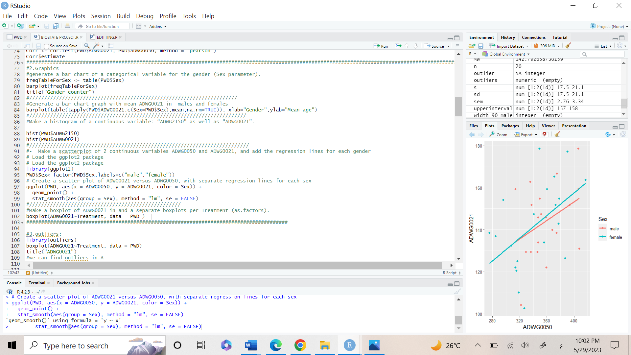
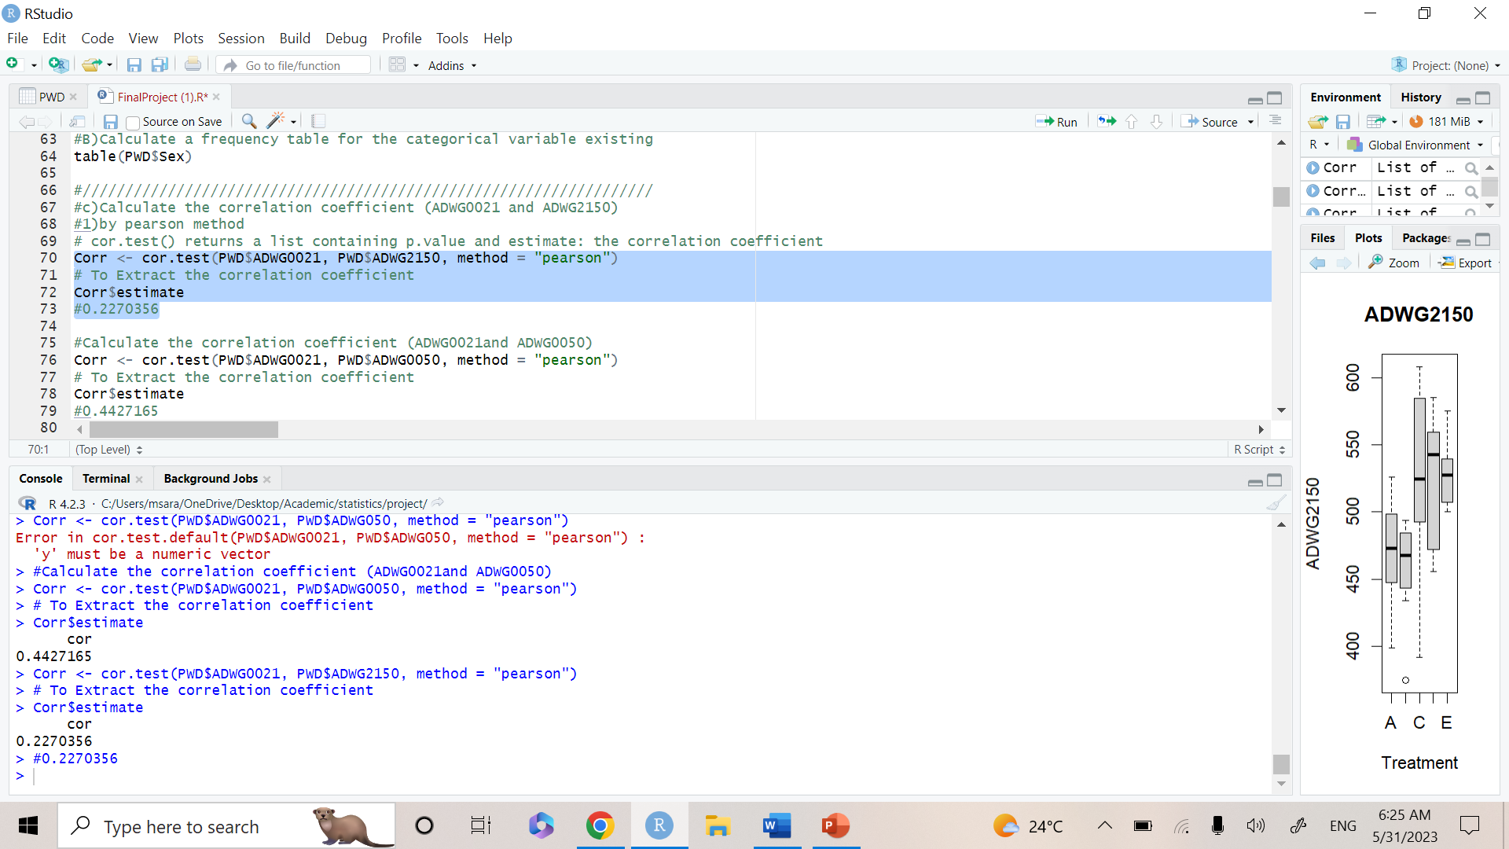
2.Graphics
3.4)Scatterplot of 2 continuous variables and make regression line.
The correlation indicates weak positive correlation

Slide 15
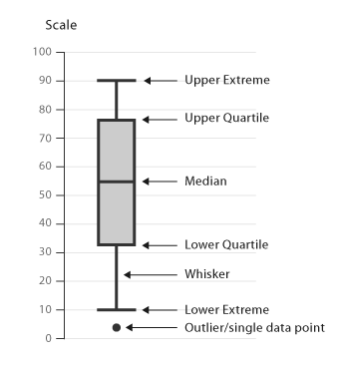
2.Graphics
Before going to the outliers , we need to clarify the following.
Box plots can visualize the quartiles.
Second quartile is median.
Median is affected by the spread of data.
Data range is between (lower extreme - upper extreme).
Any point beyond the extreme is called OUTLIER.

Slide 16
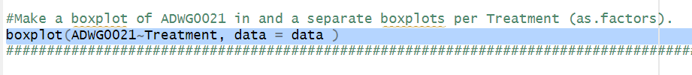
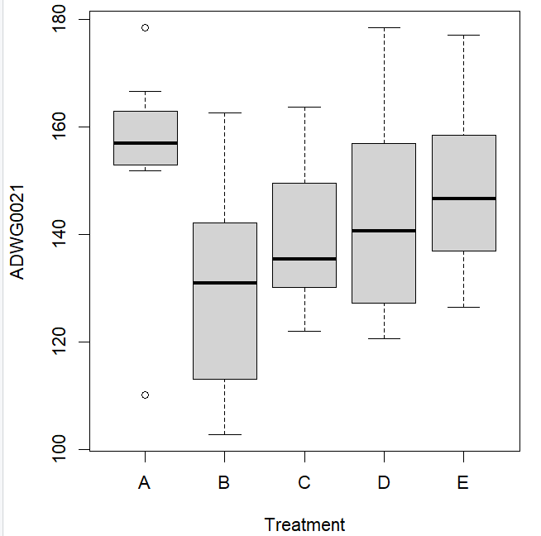
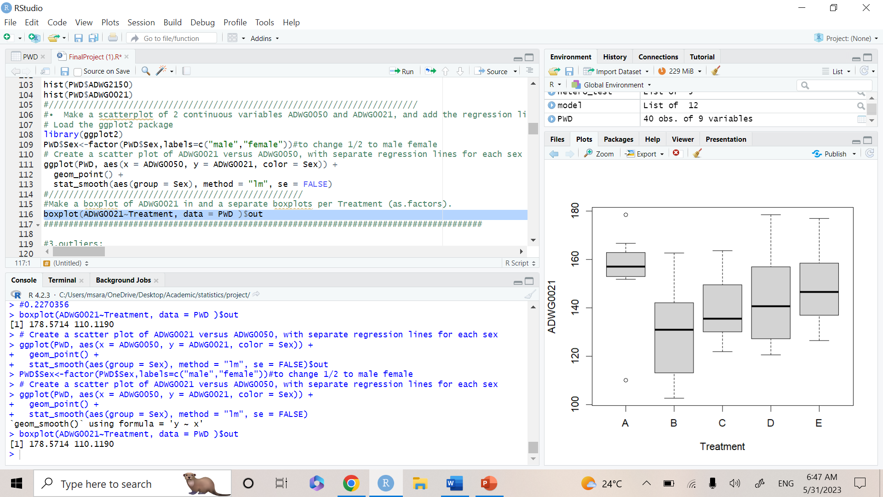
2.Graphics
Boxplot of ADWG0021 and separate boxplots per Treatment
The code
Box plots( whisker plot) are used is a type of chart used to visualize the distribution of a numerical variable.
It displays the median, quartiles, and outliers of the data in a compact format
outliers

Slide 17
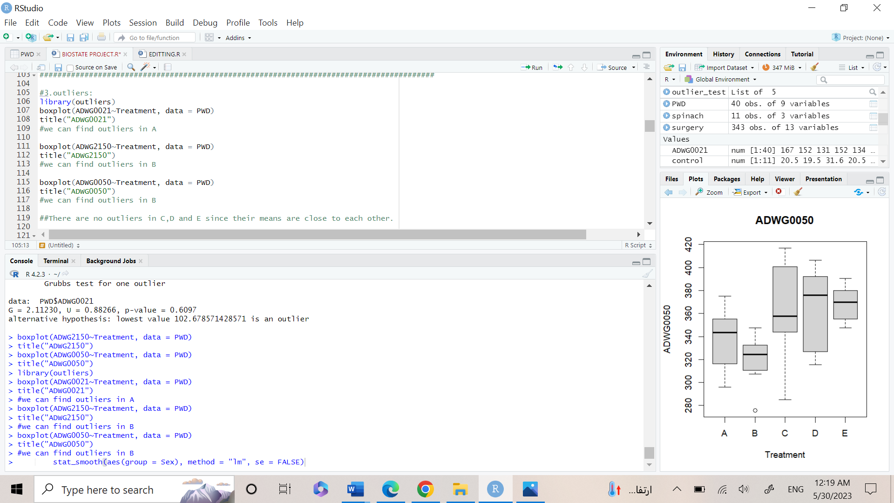
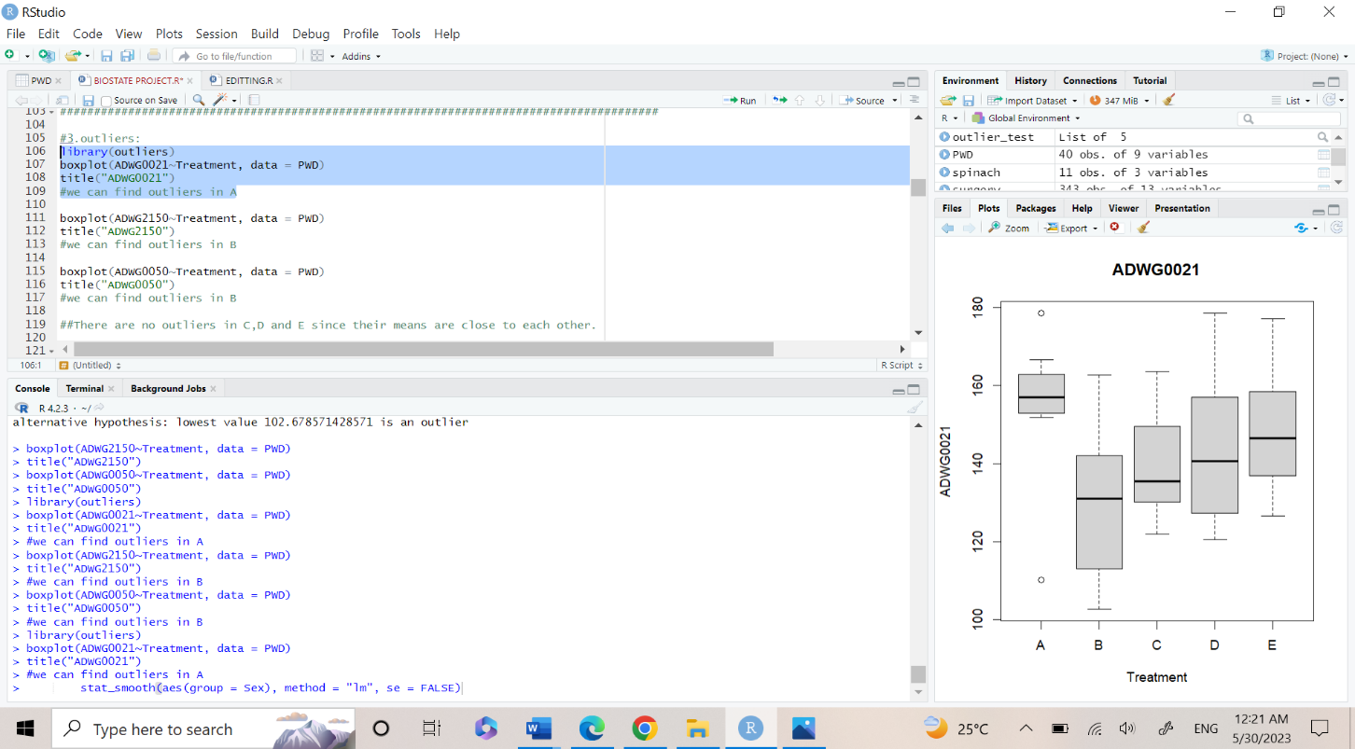
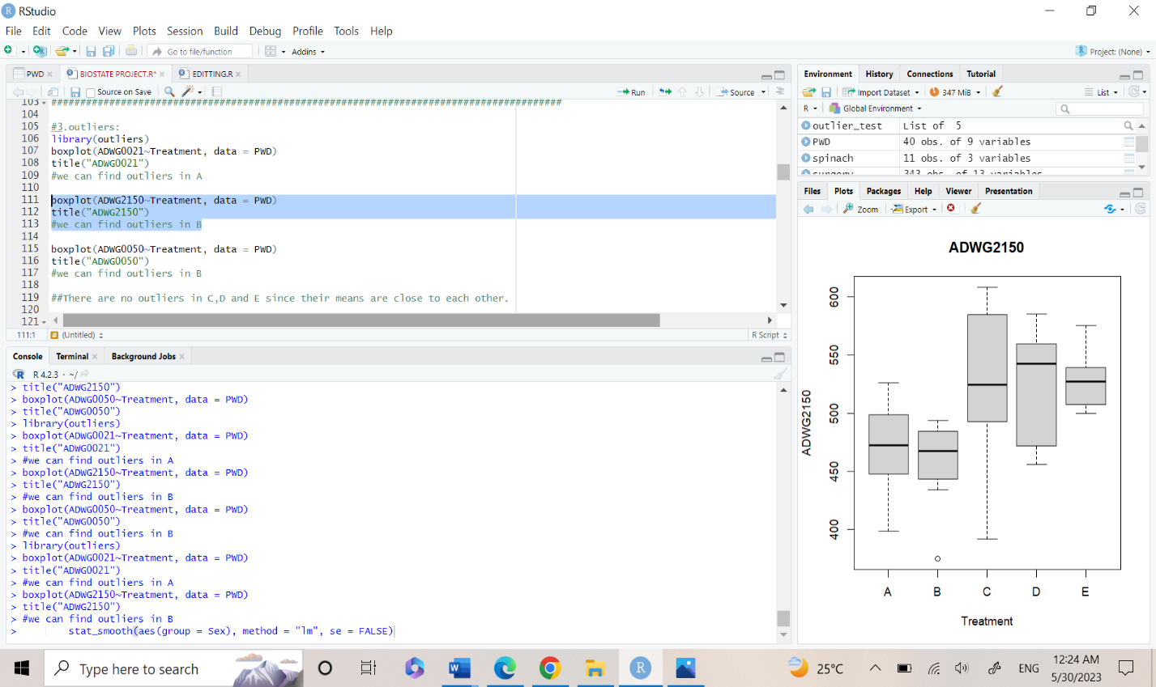
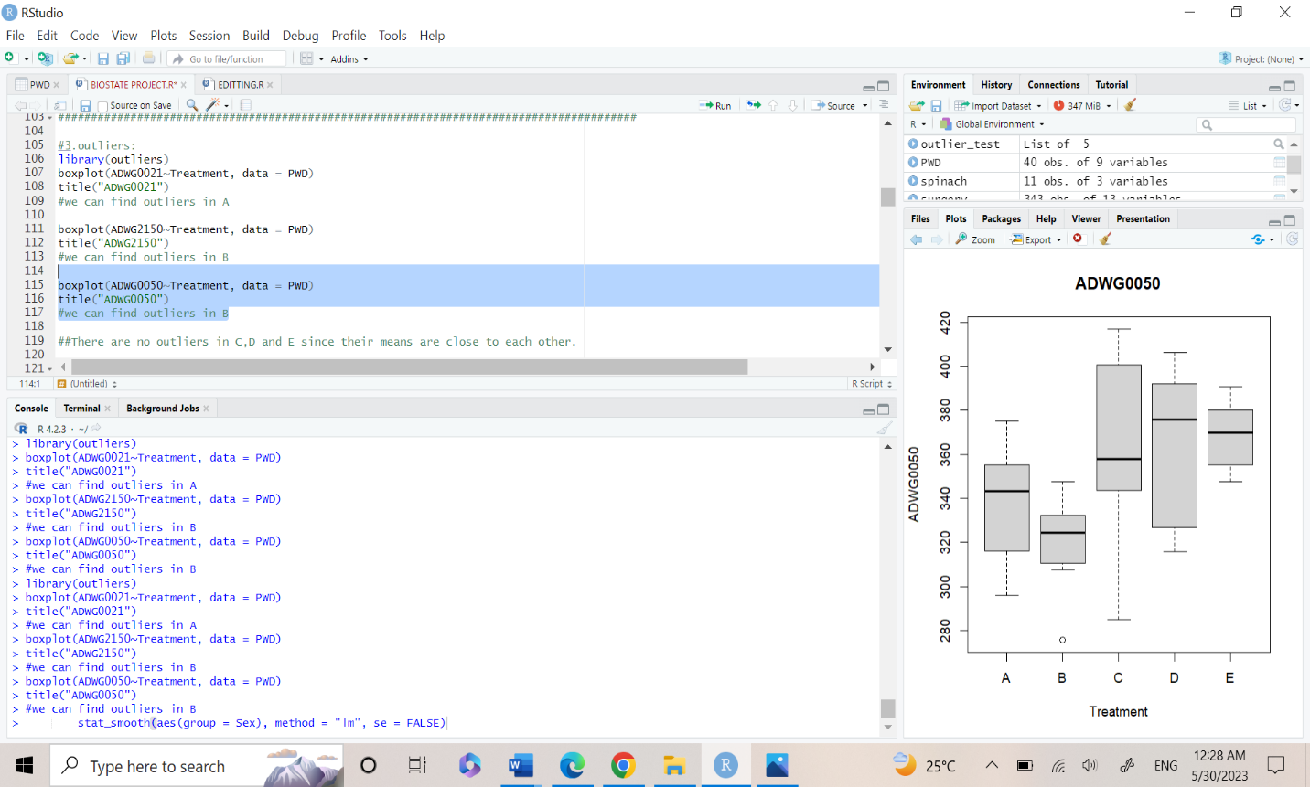
3.Outliers
Outliers are extreme or unusual values in a dataset that differ significantly from the majority of the other observations.
The code

Slide 18
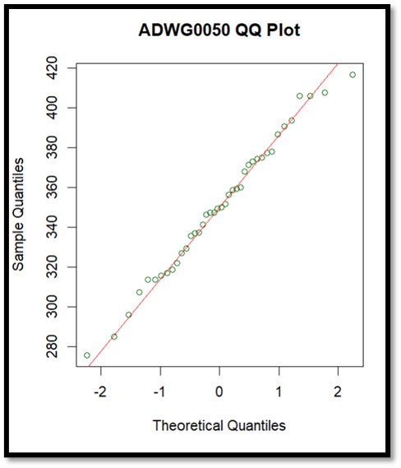
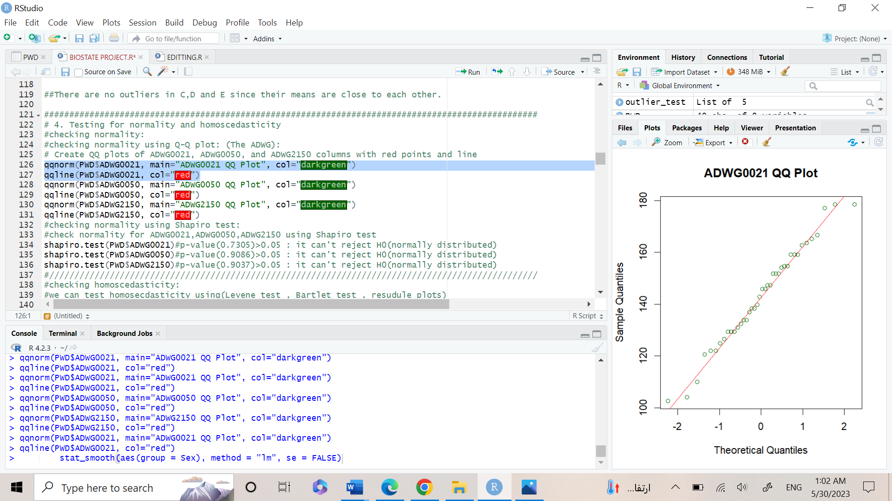
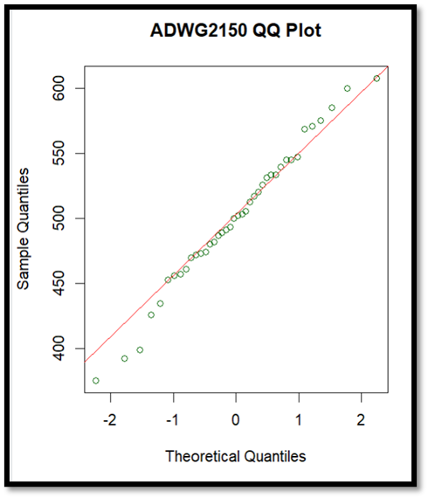
4)Testing for normality/ homoscedasticity QQ-PLOT
Graphs reflect normal distribution because the plotting between the observed versus the expected follow a line.

Slide 19
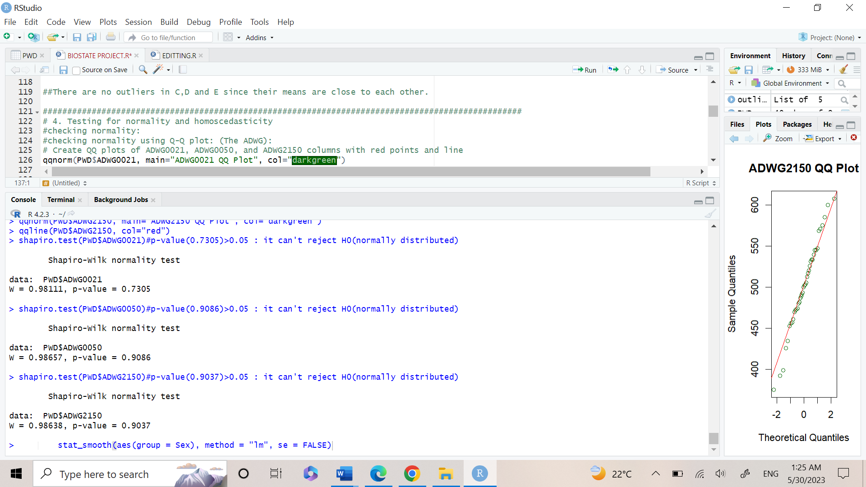
Shapiro Test
Result of Shapiro test in ADWG0021, ADWG0050, ADWG2150 p-value>0.05: not enough evidence to reject null hypothesis.

Slide 20
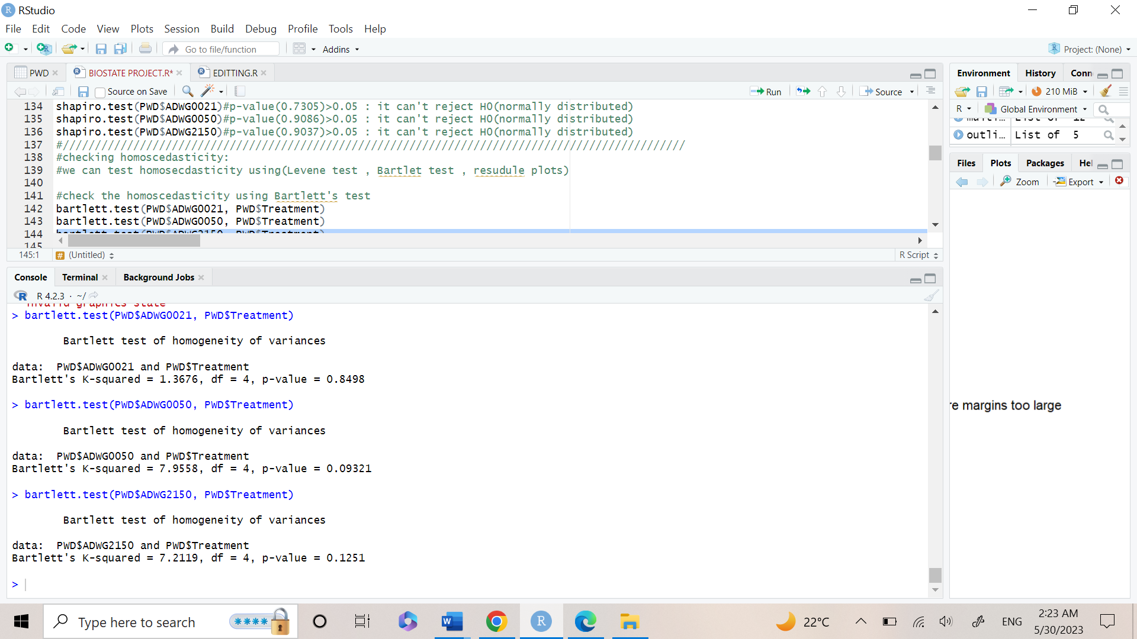
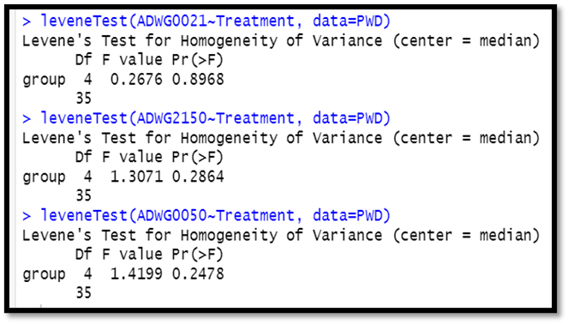
homoscedasticity
1st : Bartlet Test
Result of Bartlet test in ADWG0021, ADWG0050, ADWG2150:
p-value>0.05: not enough evidence to reject null hypothesis.
2nd: Using Levene’s test:
Result of Levene test in ADWG0021, ADWG0050, ADWG2150 p-value>0.05: not enough evidence to reject null hypothesis.

Slide 21
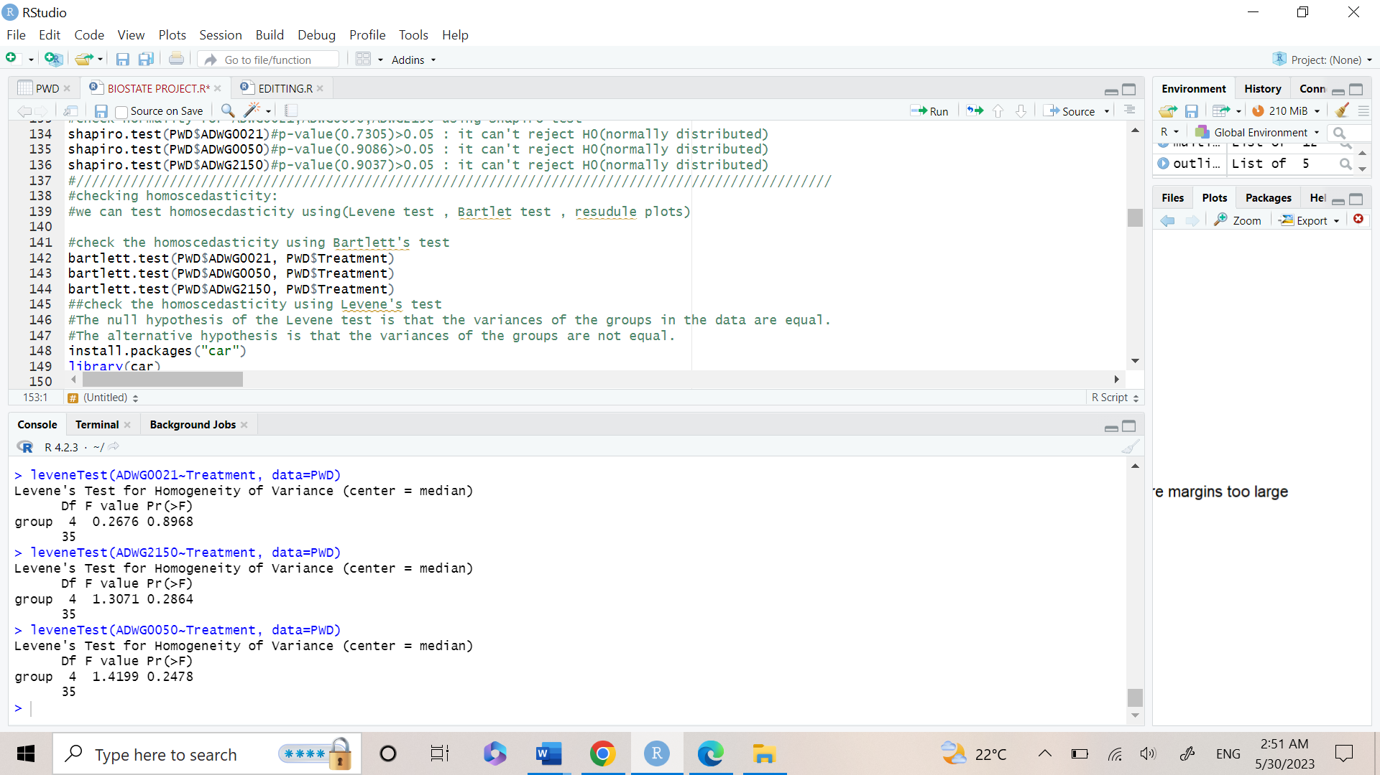
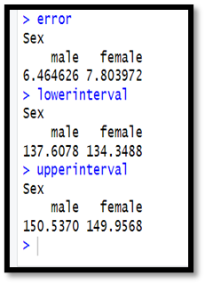
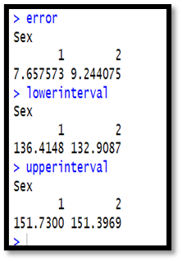
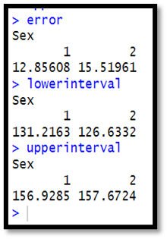
Statistical Inference
We noticed that by increasing the confidence interval the range is wider(width increases)
therefore, the error range increase but with more certainty to have the true value included in the interval

Slide 22
Hypothesis testing
1
2
3
1
Assuming normality and homoscedasticity
Assuming heteroscedasticity
performing post-hoc testing

Slide 23
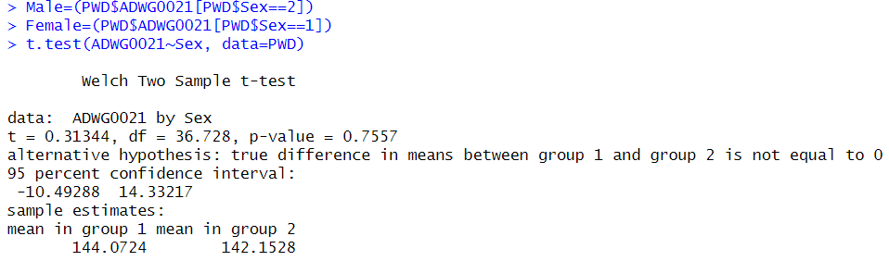
1.Assuming normality and homoscedasticity
Firstly: We hypothesis that ADWG0021 is different between males and females.
We made a two-sample t-test : since we assume normality, homoscedasticity and they are independent variables.
Sample Output:
Null hypothesis: Mean groups of male and female are not different (Equal)
Alternative hypothesis : Mean groups male and female are different
P-VALUE= 0.7 > 0.05 { Since p-value is greater than alpha value(0.05) which means that we don’t have enough evidence to reject null hypothesis and supporting alternative hypothesis }.
Code:

Slide 24
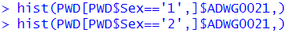
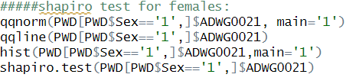
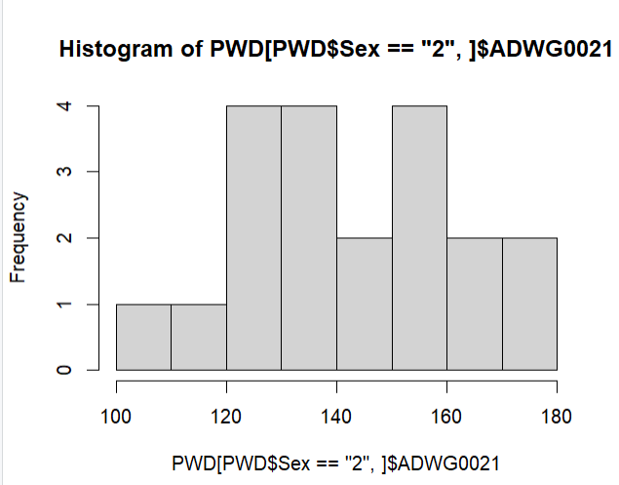
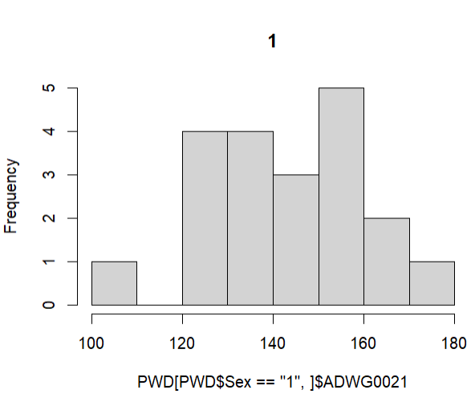
Assess whether the previous test assumptions have been met for the test(Normality)
For testing normality, we use Histogram, Q-Q plots and Shapiro-test.
Null hypothesis is that our data is normally distributed.
Our Alternative hypothesis is that our data is not normally distributed.
Then we compared P-value to the significance level(Alpha=0.05)
1)Histogram
Code for Females:
Code for Males:
Sample output:
Sample output:
Histograms doesn’t describe whether the data is normally distributed or not, so we used Shapiro-test to check the normality of the data.

Slide 25
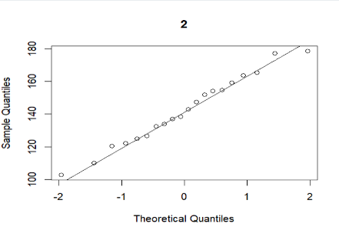
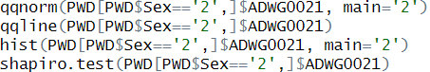
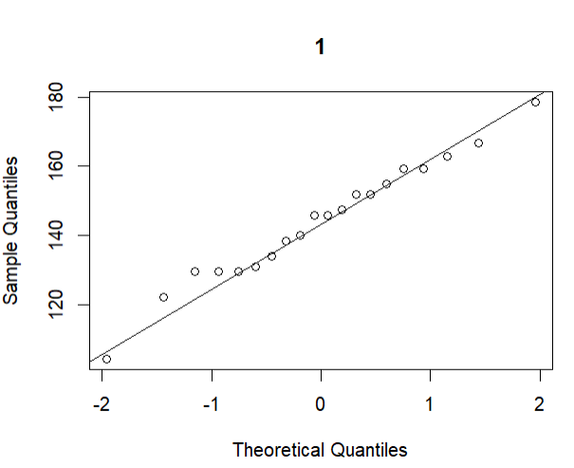
Assess whether the previous test assumptions have been met for the test (Normality)
2) Q-Q plots
Code for males:
Sample output:
Code for Females:
Sample output:
Since points on the plot fall close to the line, it indicates that the data is normally distributed.

Slide 26
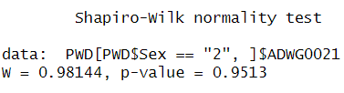
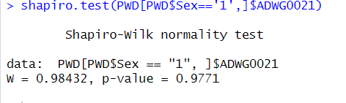
Assess whether the previous test assumptions have been met for the test(Normality)
2) Shapiro-tests:
Sample output:
Our The null hypothesis : data is normally distributed
The alternative hypothesis : data is not normally distributed
Shapiro-test output : P-value= 0.9513 Since p-value is greater than alpha value(0.05) which means that we don’t have enough evidence to reject null hypothesis and supporting alternative hypothesis }.
Code for males:
Code for Females:
Sample output: Our The null hypothesis : data is normally distributed
The alternative hypothesis : data is not normally distributed
Shapiro-test output : P-value= 0.98432 Since p-value is greater than alpha value(0.05) which means that we don’t have enough evidence to reject null hypothesis and supporting alternative hypothesis }.
In conclusion: (For proving normality of our data)
Since p-values of both males and females > alpha(0.05) , then we don't have enough evidence to reject the null hypothesis and support the alternative hypothesis.
We assume normality(no enough evidence to support non normality) ,so previous test assumptions have been met for the normality test, Therefore we proved normality using Histogram, Q-Q-plot and Shapiro-test.

Slide 27
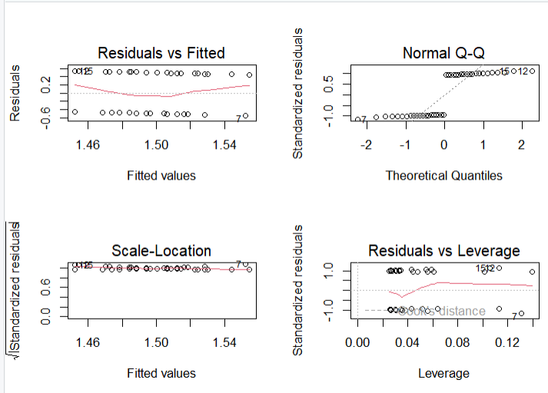
Assess whether the previous test assumptions have been met for the test(homoscedasticity)
The code is used to fit a linear regression model to the relationship between ADWG0021 and Sex and create a set of four diagnostic plots of the model to assess the assumptions of the model and identify any potential issues with the model fit or the data.
Output:
The scatterplot of the fitted values against the dependent variable can help identifpatterns in the relationship between the variables, such as linearity or curvature.
The Q-Q plot of residuals can help assess the normality of the residuals.
The plot of residuals against the fitted values can help identify homoscedasticity (Equal variances) or nonlinear relationships.
In Scale-Location : checks the Variance and from the output it indicates that the data is homoscedastic since all points are close to a straight line.

Slide 28
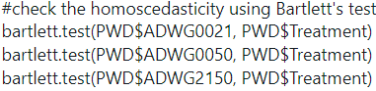
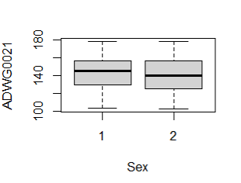
Assess whether the previous test assumptions have been met for the test(homoscedasticity)
In Bartlett's test :
The null hypothesis (HO) means there is no difference in variance, the alternative (H1) means there is differences in variance (Heteroscedastic).
From the test results : we can see that p-value equals to 0.4129 which is larger than the significant level alpha(0.05) so we do not have enough evidence to reject the null hypothesis and in support of alternative hypothesis. This concludes that we can assume our data is homoscedastic (they do have the same variance).
We also used boxplot to test their variability (having same variance).
Code:
Code:
Sample Output:
Boxplot shows that males and females have nearly the same variance as their means are too close from each others.

Slide 29
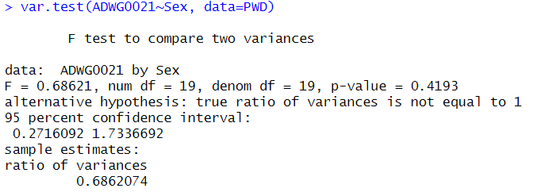
Assess whether the previous test assumptions have been met for the test(homoscedasticity)
In var.test:
using var.test() :to test whether the variances of ADWG0021 are equal between males and females in the PWD dataset.
Code:
Sample Output:
using var.test() to test whether the variances of ADWG0021 are equal between males and females in the PWD dataset.
As p-value = 0.4193 which is greater than alpha(0.05) so we don’t have enough evidence to reject null hypothesis and in support of alternative hypothesis (This concludes that we can assume our data is homoscedastic (they do have the same variance).

Slide 30
Assess whether the previous test assumptions have been met for the test(homoscedasticity)
In Bartlett's test :
The null hypothesis (HO) means there is no difference in variance, the alternative (H1) means there is differences in variance (Heteroscedastic).
From the test results : we can see that p-value equals to 0.4129 which is larger than the significant level alpha(0.05) so we do not have enough evidence to reject the null hypothesis and in support of alternative hypothesis. This concludes that we can assume our data is homoscedastic (they do have the same variance).
We also used boxplot to test their variability (having same variance).
Code:
Code:
Sample Output:
Boxplot shows that males and females have nearly the same variance as their means are too close from each others.

Slide 31
Assess whether the previous test assumptions have been met for the test(homoscedasticity)
In var.test:
using var.test() :to test whether the variances of ADWG0021 are equal between males and females in the PWD dataset.
Code:
Sample Output:
using var.test() to test whether the variances of ADWG0021 are equal between males and females in the PWD dataset.
As p-value = 0.4193 which is greater than alpha(0.05) so we don’t have enough evidence to reject null hypothesis and in support of alternative hypothesis (This concludes that we can assume our data is homoscedastic (they do have the same variance).

Slide 32
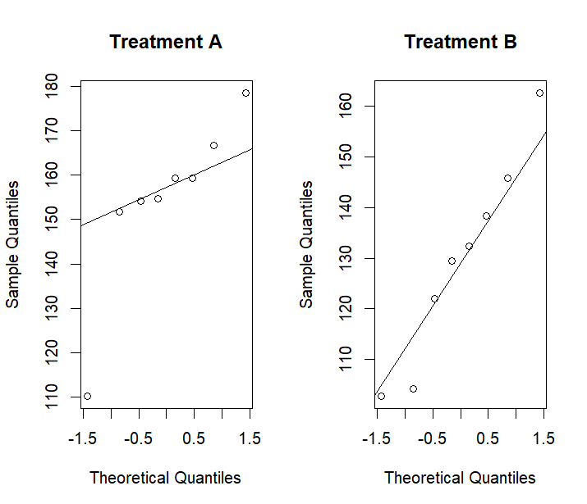
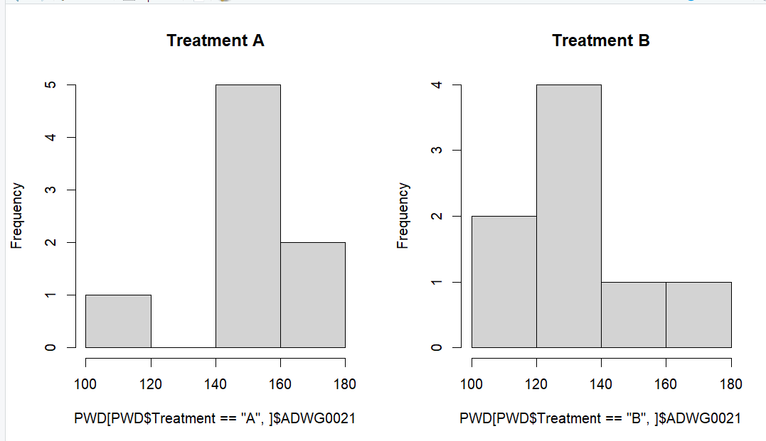
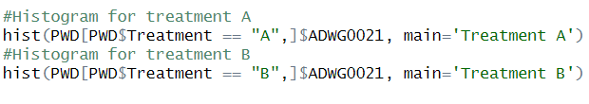
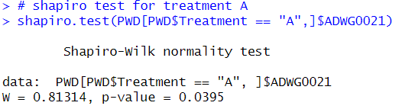

Assuming heteroscedasticity
First: We hypothesis that ADWG0021is “different” in the group receiving Treatment A compared to the Treatment B
Firstly, we should test normality of treatment A and treatment B knowing that our null hypothesis is that our data is normally distributed, and our alternative hypothesis is that our data is not normally distributed.
Treatment A
The Output:
Codes:
Results:
Histogram: the data isn’t normally distributed
Q-Q: The Median line doesn’t cover all the data, so the data isn’t normally distributed.
Shapiro-test: Since P-value(0.03) is smaller than alpha value this means that we do have enough evidence to reject null hypothesis(Data is normally distributed) and support alternative hypothesis(Data is not normally distributed)

Slide 33

Assuming heteroscedasticity
First: We hypothesis that ADWG0021is “different” in the group receiving Treatment A compared to the Treatment B
Firstly, we should test normality of treatment A and treatment B knowing that our null hypothesis is that our data is normally distributed, and our alternative hypothesis is that our data is not normally distributed.
Treatment B
The Outputs:
Codes:
Results:
Histogram: Couldn’t perfectly specify the data is normal or not
Q-Q: There are outliers, so it is not normal
Shapiro-test: Since P-value(0.8132) is greater than alpha value this means that we don’t have enough evidence to reject null hypothesis(Data is normally distributed) and support alternative hypothesis(Data is not normally distributed) So, Treatment B is normally distributed.

Slide 34

Assuming heteroscedasticity
So, we have data of treatment A not normal and data of treatment B normal
Since, we have at least one of our data not normal, therefore, we assume that the data is not normally distributed
We will use Wilcoxon test as we assumed the data is heteroscedastic and data is not normal
Code:
Output:
Wilcoxon shows that the value of P-value(0.0312) is greater that alpha value (0.05) so we do have enough evidence to reject null hypothesis (data is normally distributed) and in support of alternative hypothesis(data is not normally distributed), this means that ADWG0021 is "different" in the group receiving Treatment A compared to the Treatment B

Slide 35
Assess whether the previous test assumptions have been met for the test(heteroscedasticity)
We use Wilcoxon to test if the data is heteroscedastic (different in variance) or not
Null hypothesis: data is heteroscedastic
Alternative hypothesis : data is homoscedastic
Output:
Since P-value=0.03 which is smaller than alpha, so this means that that we do have enough evidence to reject the null hypothesis in support of alternative hypothesis which means that the variance of these groups is heteroscedastic. This means that the variance is heteroscedastic in this data not homoscedastic
Therefore, as a result of Wilcoxon and p-value ; the test doesn't meet for the assumption.

Slide 36

3) performing post-hoc testing
First, we test the assumptions ( normality and homoscedastic) for all treatments (A,B,C,D,E)
1)Testing Normality using Q-Q plots , histograms, Shapiro-test for all treatments Results: As shown in (point 4) above we found that treatment A is not normally distributed(as p-value is smaller than alpha value) while the other treatments are normally distributed as all p-values of them are greater than Alpha value(0.05) that's why we don't have enough evidence to reject null hypothesis and in support of alternative hypothesis ,So our data is normally distributed, and the treatments aren't different in ADWG0021
2)Then we test the other assumption(homoscedastic):Using Leven's test we concluded that our data is homoscedastic as p-value =0.898 which is greater than alpha(0.05) so we don't have enough evidence to reject null hypothesis(data is homoscedastic) in support of alternative hypothesis(heteroscedastic).
there is not enough evidence to prove that the variances of the ADWG0021 values are different across the five treatment groups.
Code:

Slide 37



3) performing post-hoc testing
After testing assumptions(normality and homoscedasticity) we will see if our assumptions have met for the test or not: Using Anova-test and post-hoc (performing Tukey's honest test) assuming normality and homoscedasticity
Anova test is a statistical formula used to compare variances across the means (or average) of different groups.
The aov() function is used to fit an ANOVA model.
Anova Model produces a summary of the ANOVA model.
Code:
Output:
Result of Anova test is p-value(0.101) > alpha value(0.05) so, we don't have enough evidence to reject the null hypothesis this indicates that they have same variance , therefore we can state that they are homoscedastic, and the treatments aren't different in ADWG0021.

Slide 38

3) performing post-hoc testing
After testing assumptions(normality and homoscedasticity) we will see if our assumptions have met for the test or not: After doing anova test we apply post-hoc using Tukey’s-test and dunn test
Code:
Output:
The output of the Tukey’s-test display a table of comparisons between each pair of levels of Treatment, along with the difference between the means, the standard error, the adjusted p-value, and the 95% confidence interval for the difference, But post-hoc tests can increase the chance of making a Type I error (rejecting the null hypothesis when it is true).

Slide 39

3) performing post-hoc testing
We used the Bonferroni correction method to account for multiple comparisons , also results were not significant, so we used pairwise t-test.
Code:
Output:
The output of the pairwise t.test() displays a table of comparisons between each pair of levels of treatment, along with the difference between the means, the t-statistic, the degrees of freedom, the p-value, and the adjusted p-value (after applying the Bonferroni correction).
It is important to note that the pairwise t-test with Bonferroni adjustment is a conservative approach, which increases the chance of making a Type II error especially when the sample size is small, or the variances are unequal.
The table indicates which pairs of levels are significantly different from each other based on p-values.
Treatment A and B give p-values smaller than alpha while other treatments give p-values greater than alpha value
so ADWG0021 is not different between the treatments expect for treatment A and B.
Kruskal-Wallis test assesses the differences against the average ranks in order to determine whether or not they are likely to have come from samples drawn from the same

